Slide 1
L05 – Estimation
FIT2101: Software Engineering Process and Management
S2 2020

Slide 2
In this lecture…
Why estimation is hard
Story points
Tips for estimating user stories

Slide 3
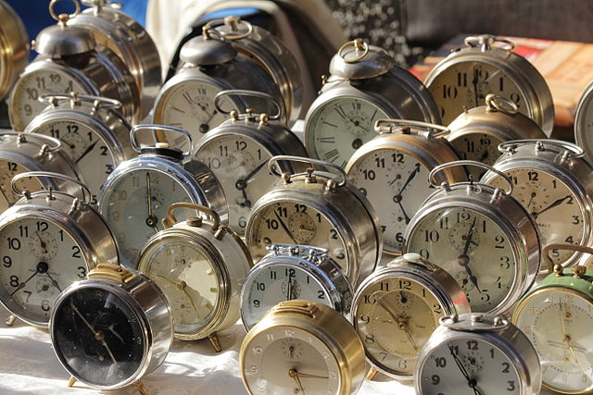
Estimation
If you want to be able to deliver software on time, you will need to be able to figure out how long it will take to build each feature, and how much it will cost. This is estimation.

Slide 4
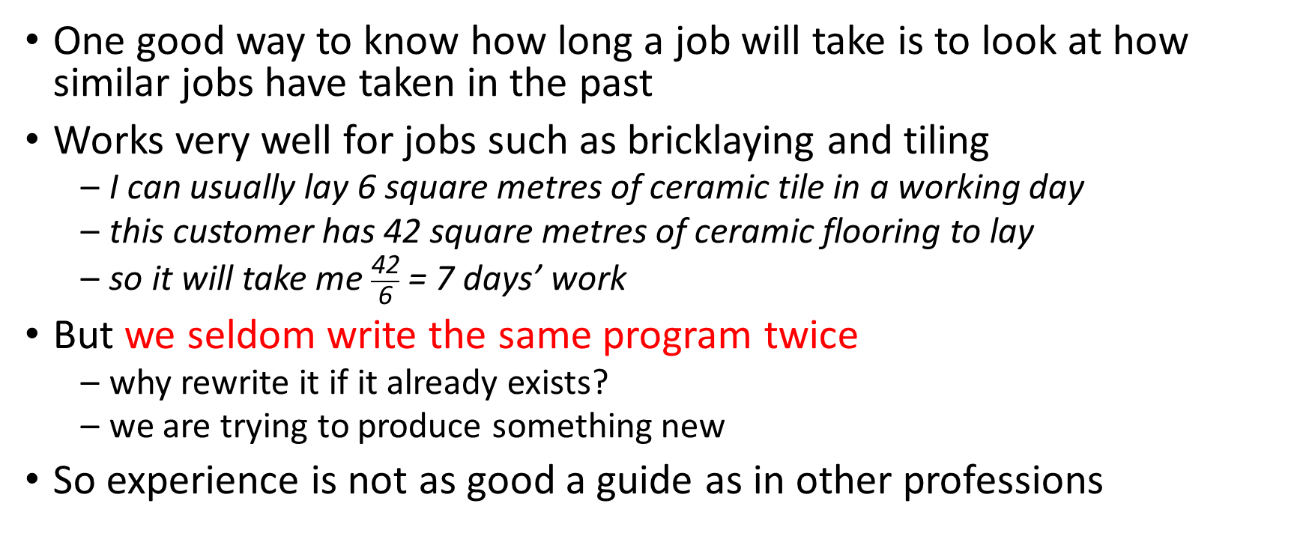
Software estimation is hard
One good way to know how long a job will take is to look at how similar jobs have taken in the past
Works very well for jobs such as bricklaying and tiling
I can usually lay 6 square metres of ceramic tile in a working day
this customer has 42 square metres of ceramic flooring to lay
so it will take me $\frac{\text{42}}{\text{6}}$ = 7 days’ work
But we seldom write the same program twice
why rewrite it if it already exists?
we are trying to produce something new
So experience is not as good a guide as in other professions

Slide 5
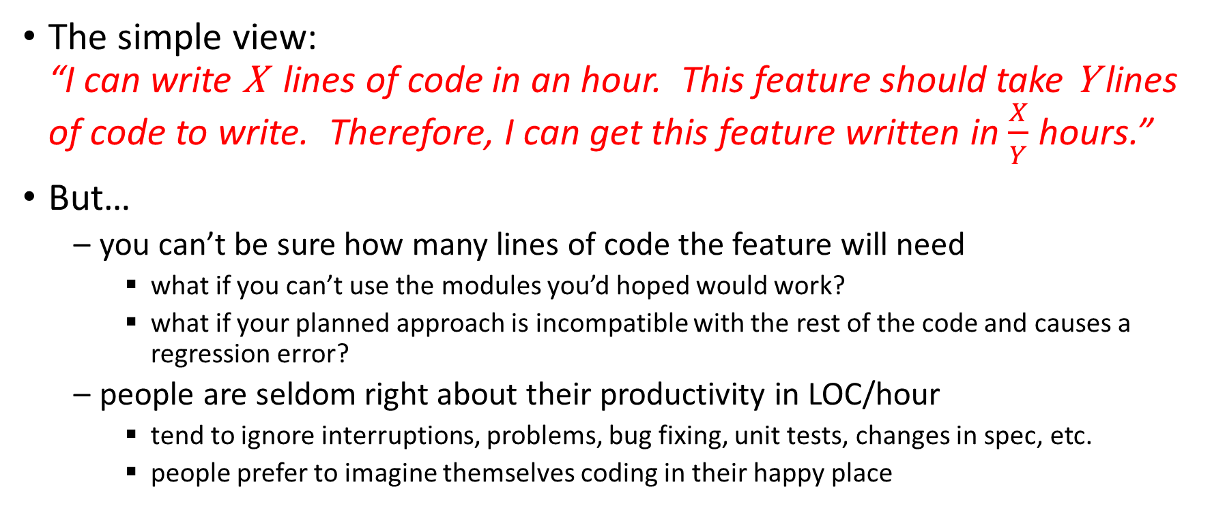
Estimation is hard
The simple view: “I can write X lines of code in an hour. This feature should take Y lines of code to write. Therefore, I can get this feature written in $\frac{X}{Y}$ hours.”
But…
you can’t be sure how many lines of code the feature will need
what if you can’t use the modules you’d hoped would work?
what if your planned approach is incompatible with the rest of the code and causes a regression error?
people are seldom right about their productivity in LOC/hour
tend to ignore interruptions, problems, bug fixing, unit tests, changes in spec, etc.
people prefer to imagine themselves coding in their happy place
Notes:
In my (Robyn’s) experience, second year students usually estimate their productivity at around 30 LOC/hour for designed and debugged code. In practice, they usually produce about 10 LOC/hour, with debugging that is usually incomplete.

Slide 6
Agile estimation is especially hard
“I want you to write some software for me. How long will it take you?”
The correct answer is probably I have no idea!
you don’t know what I want yet, so how can you possibly guess?
One problem with Agile’s acceptance of requirements change is that it’s very hard to estimate how long things will take
but traditional process models don’t do much better
they cope very badly with requirements change or errors in analysis

Slide 7
Absolute and relative estimation
Absolute estimation: “Task A will take me 5 days, and task B will take me 1 day”
Relative estimation: “Task A will take me a lot longer than task B”
Absolute estimates turn out to be much less accurate than relative estimates

Slide 8
Why is estimation hard?
The team does not have complete control over the project and its environment
circumstances can change
even good risk mitigation can’t fix every development problem
One good predictor of future performance is historical performance on previous, similar projects
but are you really likely to write the same project twice?
in some fields, nearly all software projects are novel (e.g. research, game development)
Notes:
Both game development and research are fundamentally focused on creating something new – this might not apply to the Nth iteration of an EA Sports gridiron game, in which very little changes from release to release, but most game development is not done within such narrow franchises. And yet both game development and research must still plan and budget.

Slide 9
Why is estimation hard?
Human cognitive biases (i.e. our built-in tendencies to be wrong in certain ways)
the planning fallacy: we tend to underestimate the time a future project will take us, even if we have completed similar projects in the past
wishful thinking
The Dunning-Kruger effect: you don’t know how much you don’t know
if you’re unaware of the complexities, you will tend to assume it’s simple
this is one reason that nontechnical stakeholders underestimate software effort!
Hofstadter's Law: It always takes longer than you expect, even when you take into account Hofstadter's Law. — Douglas Hofstadter, Gödel, Escher, Bach: An Eternal Golden Braid

Slide 10
The trouble with precision
People tend to want to be precise in their estimates (e.g. estimating down to the day or hour)
This is much harder!
Will this take 55 hours or 56 hours?
this difference usually doesn’t matter
compare: Will this take more than a day? Will this take more than a week?
Precision is especially challenging when the tasks you’re estimating aren’t well understood
Notes:
Imagine you’re a teacher trying to mark an essay. Experienced markers can usually assign a letter grade (N, P, C, D, HD) quickly and consistently. But if they are asked to mark out of 100, the marking becomes much slower and consistency declines – that is, they found it harder to estimate the student’s mastery of the topic. They tend to get bogged down over whether a particular piece was worth 77 or 78, and because relative estimates are easier than absolute, they fixate on small quality differences between similar essays: “this one is better than the one I gave 77 but not as good as the one I gave 78, so I suppose I should give 77.5 – or should I just start over again?”

Slide 11
The trouble with time
It’s natural to want to estimate your programming tasks in terms of the time they will take
Unfortunately, people are especially bad at doing this
as we saw earlier, we tend to overlook the possibility that we will be affected by external factors (interruptions, domestic emergency, etc.)

Slide 12
“Ideal time”
One possibility: estimate your tasks in terms of the ideal time they would take
Ideal time is the amount of time a task would take you if nothing goes wrong
no changes in story or priority
no interruptions or meetings
no crises at home or illness
Easy for everyone to understand (everybody knows what an hour is)
Takes into account cognitive biases
Doesn’t translate directly into “calendar time” (i.e. real time)
it looks like it ought to but the assumptions it makes are unrealistic
can give the team a false sense of security about the accuracy of calendar-time estimates

Slide 13
Story points
Most Agile teams estimate the size of their user stories in story points
These do not correspond to clock time or ideal time, and they’re not supposed to
the idea is that we’ll eliminate cognitive biases that arise from trying to predict based on time
we are better at relative estimation; with time out of the picture, we are free to concentrate on comparing user stories rather than trying to guess their sizes accurately
Notes:
We can disengage our estimation from the cognitive biases inherent in the use of real-time estimation by making up “story points” and using them to estimate story size.

Slide 14
Story points
In order to help avoid the problems with precision, teams usually don’t allow free choice of numeric story points
there are predefined story sizes
instead of estimating the story, think of it as choosing a size
Smaller stories are easier to estimate accurately than larger stories, so many teams use systems where larger sizes are further apart
e.g. Fibonacci: 0, 1, 2, 3, 5, 8, 13, 21, 34, 55, 89
or modified Fibonacci: 0, ½, 1, 2, 3, 5, 8, 13, 20, 40, 100
or powers of 2: 0, 1, 2, 4, 8, 16
Another possibility: T-shirt sizes
S: small (a few hours)
M: medium (a day or so)
L: large (a week or so)
XL: extra large (definitely bigger than a week)

Slide 15
Story points and user stories
Using story points or T-shirt sizes can help you refine your user stories
If you find that your backlog is full of large-point (or L-XL) stories it could mean that you’re not breaking down your stories finely enough before sprint planning
remember, smaller stories are easier to estimate
also easier to fit into sprints
If your stories are nearly all small-point (or S) stories then you might be breaking them down too finely
check that these small stories are still adding customer value
are you doing “requirements management” or “top-down design”?
Notes:
Refining the project backlog is done during backlog grooming sessions – we’ll cover that next week.

Slide 16
Planning poker

Slide 17
Planning poker®
Planning poker is a gamified technique for estimating user stories
it is designed to avoid morale-sapping arguments
it is designed to get around several of the cognitive biases that make accurate estimation hard
Based around consensus: tap into the whole team’s expertise and understanding to come up with estimates
Derived from a form-based technique called Wideband Delphi that was invented by Barry Boehm in the ’70s-’80s
First described by James Grenning in 2002
Current version was designed and popularized by Mike Cohn
the trademark is registered to him and his company, Mountain Goat Software
Notes:
We’ve seen Barry Boehm before. He invented Spiral methodology and is still one of its major proponents.
We’ve also seen Mike Cohn before. He’s one of the founders of Scrum, a founding member of both the Agile Alliance and the Scrum Alliance, and the originator of the As a… I want… so that… format for user stories. He’s also written several good books on Agile requirements management and estimation.

Slide 18
Playing Planning Poker®
First, make a list of the stories you’re going to estimate in this session
Get the team and Product Owner together and give each participant a deck of planning poker cards
these cards should show the story sizes your team uses, one per card
a “deck” has one card of each size in it
decks can be purchased from many different sellers
can also make your own, e.g. using index cards
Each user story is estimated in one round of Planning Poker
Notes:
History of planning poker

Slide 19
A round of planning poker
The Product Owner talks the team through a user story
the team asks questions until each member is reasonably sure they know what their estimate will be
Each team member pulls out the card corresponding to their estimate and puts it in front of themselves, face down
On a signal from the PO or Scrum Master, all team members turn their cards over
doing this at the same time avoids the problem of anchoring, in which whichever estimate is mentioned first sets expectations for all other participants
makes it more likely that diverse opinions will be heard (because speaking first doesn’t mean you’re more likely to be right)
If there are big differences between maximum and minimum estimates, the estimators who put them forward explain their reasoning and the round is played again
Otherwise, the team negotiates a consensus
Cards are returned to their decks between rounds
Notes:
How planning poker works

Slide 20
Planning poker tools
Can purchase decks from several different sellers
modified Fibonacci seems to be most popular
often has extra cards:
∞ (infinity): too big to estimate
☕ (coffee cup): let’s take a break
Online planning poker tools and phone apps are available
useful for teams who have remote members
or who would simply prefer to use an online tool or mobile phone app rather than wrangling decks of cards
example: http://www.planningpoker.com
example: http://www.planitpoker.com

Slide 21
Velocity
Using story points gives us a new way of understanding how quickly we are making progress: velocity
the number of story points we can implement in a single sprint
without having to work at an unsustainable pace
remember that working at a sustainable pace is one of the Agile principles
For the first few sprints, expected velocity is a matter of guesswork
not sure about estimation yet
might have teething problems at the start of development: team issues, etc.
After a while, it usually settles down to a steady pace of development

Slide 22
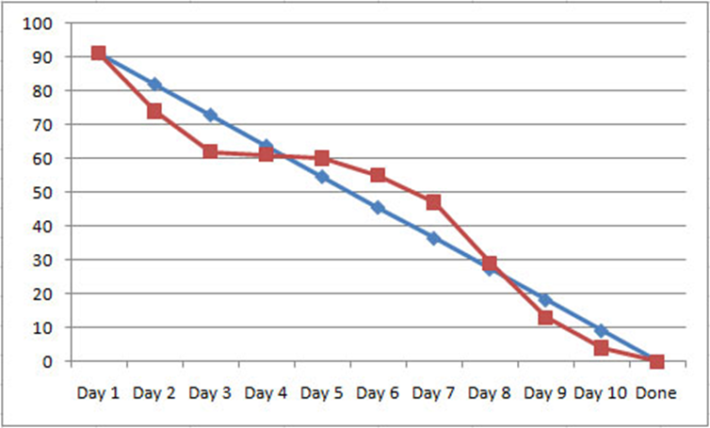
Sprint burndown charts
Can graph your team’s progress through a sprint
Y axis shows story points remaining in sprint backlog
X axis shows day of sprint
Remember: stories don’t leave the backlog until they meet your team’s Definition of Done
This chart shows progress on a ten-day sprint
red line shows actual progress, blue line shows projected progress
This team didn’t make much progress between days 3 and 5
by day 6 they were noticeably behind
they were able to catch up by day 8 and finished the sprint on time

Slide 23
A warning
Be very careful using story points as a way to measure developers’ performance
if team members end up competing, they will rush their code
rushed code is buggy code
working at an unsustainable pace causes burnout, and that destroys team morale and makes their code worse
Notes:
Don’t tie story points (or other metrics) to notions of job performance – racing to get code out the door usually ends up with buggy code. Even if you can get good code out, if the pace isn’t sustainable then you’re setting yourself up for failure later.

Slide 24
The “No Estimates” movement
Some software engineers strongly dislike estimation
as we’ve seen, it is seldom done well
tends to create unrealistic expectations
Some have suggested reducing or even eliminating estimation
e.g. Ron Jefferies, one of the founders of Scrum: recommends only estimating some user stories
for more information, check the #NoEstimates hashtag on twitter
note that very few NoEstimates advocates want to completely eliminate estimation: it helps us understand our user stories if we try to identify what will make them easy/hard
NoEstimates practitioners focus on very frequent delivery to customer
Notes:
This slide is hidden because #NoEstimates is really quite small. It’s relevant if you want to look at (e.g.) Lean though – Lean focuses on eliminating wasted effort, and inaccurate estimation is definitely a waste of effort.

Slide 25
Summary
Why estimation is hard
Story points
Planning poker
Velocity and burndown charts
Notes:
Fun fact: I estimated that this slide deck would take me about four hours to produce. It’s taken me eight so far.

Slide 26
Next lecture
Reviews and retrospectives

